Slide 1
DriverPass System Analysis
Brandon Hobbs
Notes:
BHobbs. CS-255, June 11, 2022

Slide 2
Requirements Gathering
Functional Requirements
The Learning Management System (LMS) shall allow for multiple roles within the application, e.g., Learners, Educators, and Administrators
The LMS shall have a Reporting module
Non-functional Requirements
The LMS server architecture shall be designed to be scalable
The LMS shall be accessed through an internet browser
Notes:
To ensure all users are only able to manipulate some data, the Learning Management System (LMS) shall allow for multiple roles within the application, e.g., Learners, Educators, and Administrators
The system needs to allows for a hierarchy in the users’ interactions with the LMS. For example, you would not want a Learner to publish a lesson nor would you want an Educator to be able to delete the enrolled students database.
To allow for offline review of business intelligence, the LMS shall have a Reporting module
Educators will need the ability to evaluate large amounts of data or see a summary of data. For example, an Educator may want to know how many ‘A’, ‘B’, and ‘C’ exist within a current course, a past semester, or the previous 5 years.
To prevent worse performance as the user-base grows, The LMS server architecture shall be designed to be scalable
Learners and Educators will not want to be exposed to higher latency as the user-base grows. Moreover, users will not want to lose the ability to store data as the base grows.
The LMS shall be accessed through an internet browser
Internet access via a browser allows for users to engage the LMS from their laptops and mobile devices which enriches the user experience.

Slide 3
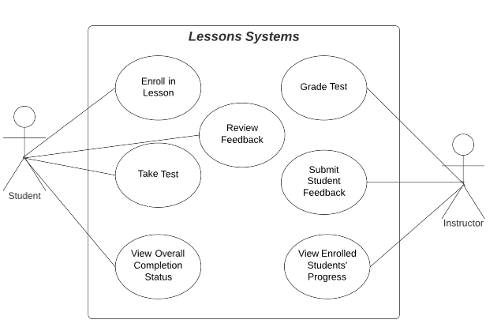
Use Case Diagrams
The larger, LMS system was decomposed into smaller sub-systems
Use cases were built based on sub-systems to aide clarity
Subsequent slides show these detailed views
Notes:
[Explain your diagram. Who are the different actors in the system? What are the different use cases? How did you account for DriverPass’s needs in your design? In your explanation, keep your audience in mind. Avoid the use of terms like “actors” and “use cases” in your explanation.]
The Lessons Sub-system is the heart of the LMS. This is the main workflow between the Students and the Instructors. Students will need to Enroll In Lesson Modules, Review any Feedback, Take Tests, and View their Completion Status.
Instructors will need to grade the student’s tests, write and submit any feedback, and also review their rosters.

Slide 4
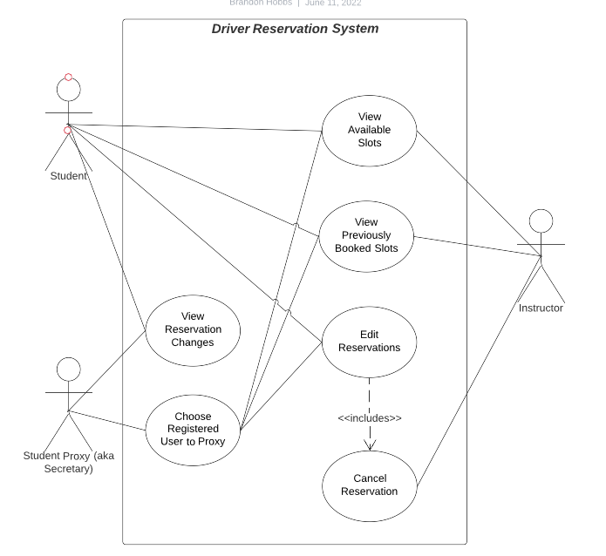
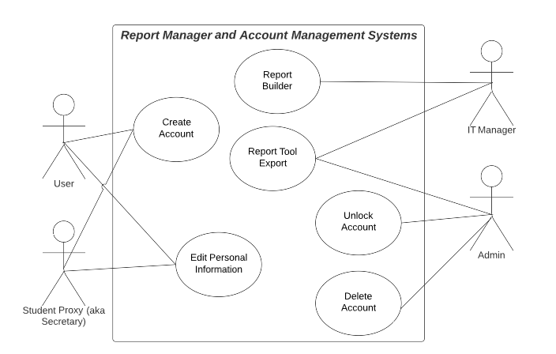
Use Case - slide 2
Notes:
The transcript of the JAD mentioned that students have 2 ways to interact with the LMS. Enroll in lessons and then take tests to understand the theoretical information and also reserve actual driving time. For the reservation system you’d have 3 actors: Student, Proxy, and Instructor.
The transcript also mentioned that the secretary may “help” others to enroll so there needs to be proxy-based functionality so the secretary may “impersonate” another user. The Instructor would of course also need some interactions. For example, he might need to cancel some appointments (maybe the vehicle broke down, maybe he’s over booked, or out sick).
Liam mentioned he’d want to do some business analysis offline, i.e., Excel. This means there will need to be some sort of Reporting tools and thus a Report Management tool. The actors would be the IT Manager and the Admins. The IT Manager would be able to build the reports so the Admins could consume them.
The system will also need a way to manage accounts, e.g., create accounts, delete accounts, unlock accounts with too many failed logins, The transcript also suggested the Secretary (via proxy) should be able to help a student update information.

Slide 5
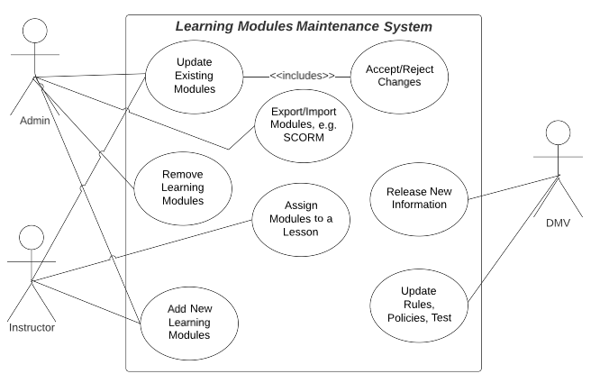
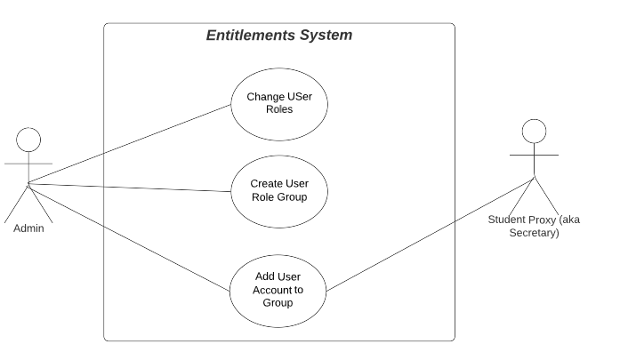
Use Case - slide 3
Notes:
The transcript mentioned that compliance and module management, e.g., lesson updates, would be important for relevancy. This means there should be a Learning Module Maintenance sub-system. The actors would be Admin, Instructors, and the “DMV”.
The DMV may publish new material that would need to be incorporated into the system. The Instructor would need to be able to create lessons/edit and then assign those to different lessons. The Admin would need to be able to curate these lessons – deleting old modules and lesson, export/import open source modules, and then reject or approve any new changes. For example, maybe the DMV pushes a bad update that is garbled or a disgruntled employee creates an offensive lesson.
Lastly, to control who can and cannot perform certain actions an Entitlement Role-based system is to be used. This will allow users to have a hierarchy of control.

Slide 6
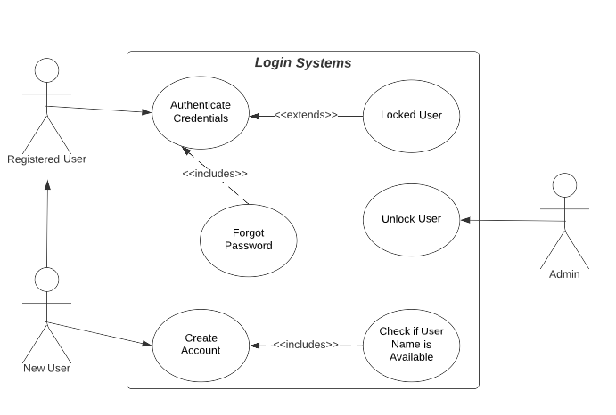
Use Case – Slide 4

Slide 7
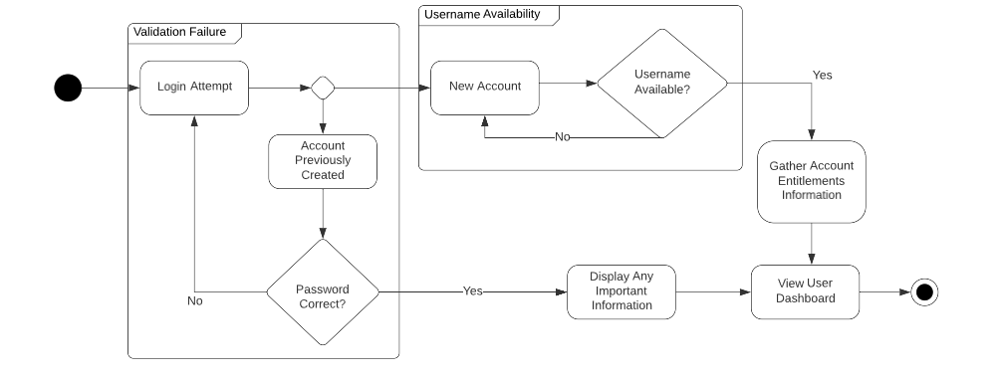
Activity Diagram
Notes:
[Explain your diagram. Which use case are you breaking down? What are the steps for this use case? How did you account for DriverPass’s needs in your design? In your explanation, keep your audience in mind. Avoid the use of technical terms such as “nodes,” “control flows,” and so on.]
The activity diagram is that of a user trying to login. There would be 2 potential types of logins: those with existing access and those with no existing access – the system needs to handle both without anyone from DRIVERPASS being involved.
The system also needs to employee uniqueness in account creation to avoid someone trying to spoof users.
After a user gains valid access they should be greeted by any news bulletins and then finally shown their User Dashboard (as shown in the transcript).

Slide 8
Addressing Security Concerns
All users will be assigned a Role, e.g., Learners, Educators, and Administrators
Entitlements will be governed by this Role
Entitlements should be assigned with the Least Privilege Principal (POLP)
Backend will be upgradeable by deploying new builds
No copyleft licenses will be employed
All databases/routers, especially those containing PII, will be encrypted
All APIs will use a hybrid approach of RSA-encrypted AES-public keys
Router traffic will be encrypted with TSL 1.2 or higher
Notes:
Security is everyone’s duty. This includes the users. To be sure that users cannot perform tasks they are not meant to the system will have an entitlements systems
Copyleft licenses expose your code base to any other users and if the library has an exploit then external parties are aware your software does too
Personal Identified Information, PII, is very important to users. There are even laws governing its treatment in some states and countries. This data must be encrypted.
Maintaining secure requests between any end points is important so that no data manipulation or leakage occurs. SSL is outdate so TSL 1.2 or higher should be employed (TSL 1.0 and 1.1 are being phased out)

Slide 9
System Limitations and Assumptions
Assumptions
Limitations
Users will have a valid email account at all times of use
Users have access to a web-capable device
System will not be fully ADA compliant for blind users
System will only be deployable in a web server and will not support FaaS and other server-less architectures
Notes:
An email will be used to identify individual users upon login. Moreover, the address must be valid for non-repudiation and other authentication needs.
Because mobility and accessibility are considered to be highly important the LMS will only be connected to via the internet, which forces users to have internet access.
Full ADA compliance means that the website is accessible for those with vision and hearing disabilities. For now, there will be no accessibility for users with vision disability.
Server technology, customer owned or IaaS, is mature enough to handle the scalability needs. Moreover, a monolithic architecture, as opposed to FaaS, is more sustainable by this engineering team and reduces time-to-market.

